Slide 1
UX for IoT

Slide 2
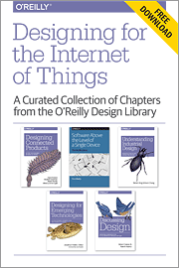
UX for connected devices
When we think of design for connected products, we tend to focus on the most visible and tangible elements:
the industrial design
the user interfaces (UIs) found in mobile and web apps and on the devices themselves.
They are important concerns, which have a major impact on the end user’s experience of the product. But they’re only part of the picture.
You could create a beautiful UI, and a stunning piece of hardware, and users could still have a poor experience of the product as a whole.

Slide 3
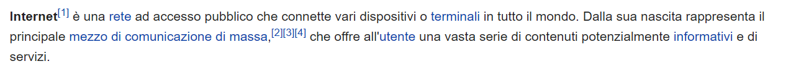

INTERNET

Slide 4
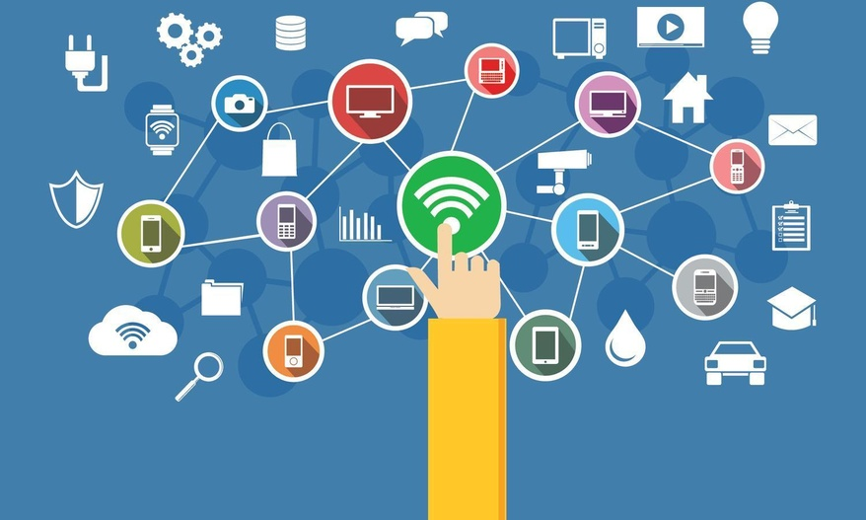
The Internet of Things
The Internet of Things (IoT) is a system of interrelated computing devices, mechanical and digital machines, objects, animals or people that are provided with unique identifiers (UIDs) and the ability to transfer data over a network without requiring human-to-human or human-to-computer interaction

Slide 5
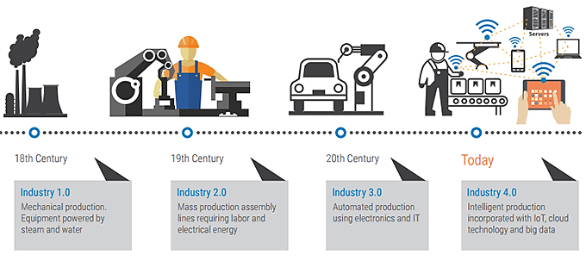
THE INDUSTRY 4.0

Slide 6

THE INDUSTRY 4.0
Industry 4.0 describes the organisation of production processes based on technology and devices autonomously communicating with each other along the value chain: a model of the ‘smart’ factory of the future where computer-driven systems monitor physical processes, create a virtual copy of the physical world and make decentralised decisions based on self-organisation mechanisms. The concept takes account of the increased digitalisation of manufacturing industries where physical objects are seamlessly integrated into the information network, allowing for decentralised production and real-time adaptation in the future.
Industry 4.0 was initially developed by the German government to create a coherent policy framework to maintain Germany’s industrial competitiveness.
From: Industry 4.0 Study for the ITRE Committee - www.europarl.europa.eu/RegData/etudes/STUD/.../IPOL_STU(2016)570007_EN.pdf

Slide 7
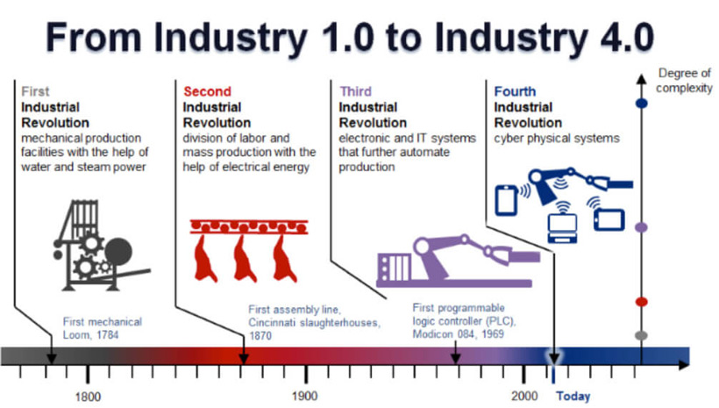
THE INDUSTRY 4.0
‹#›

Slide 8
THE INDUSTRY 4.0
‹#›

Slide 9
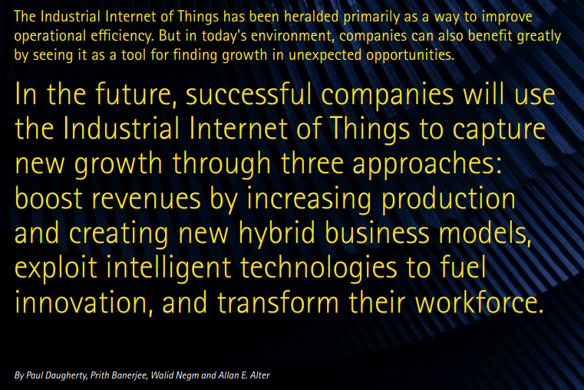
INDUSTRY 4.0
https://www.accenture.com/us-en/_acnmedia/Accenture/next-gen/reassembling-industry/pdf/Accenture-Driving-Unconventional-Growth-through-IIoT.pdf

Slide 10
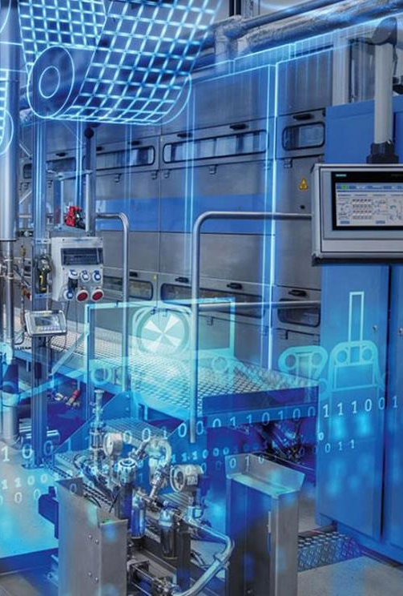
DIGITAL TWIN
A digital twin is a digital replica of a physical entity.
By bridging the physical and the virtual world, data is transmitted seamlessly allowing the virtual entity to exist simultaneously with the physical entity.
Digital twin refers to a digital replica of physical assets, processes, people, places, systems and devices that can be used for various purposes.

Slide 11
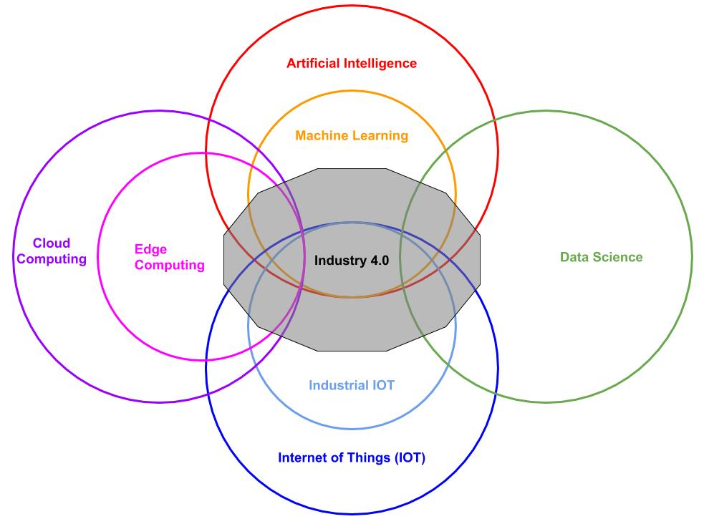
4.0 HOLISTIC VISION

Slide 12
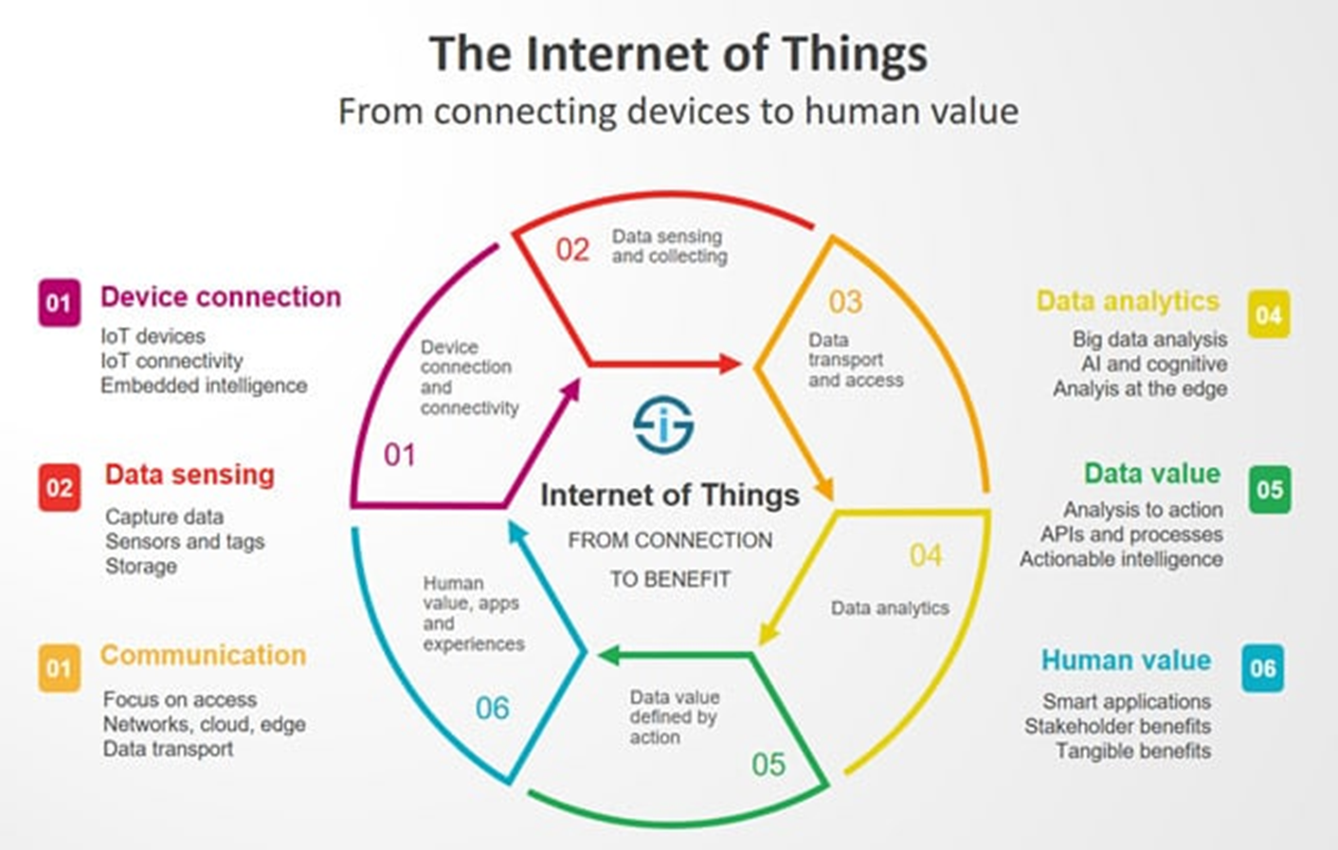

Slide 13
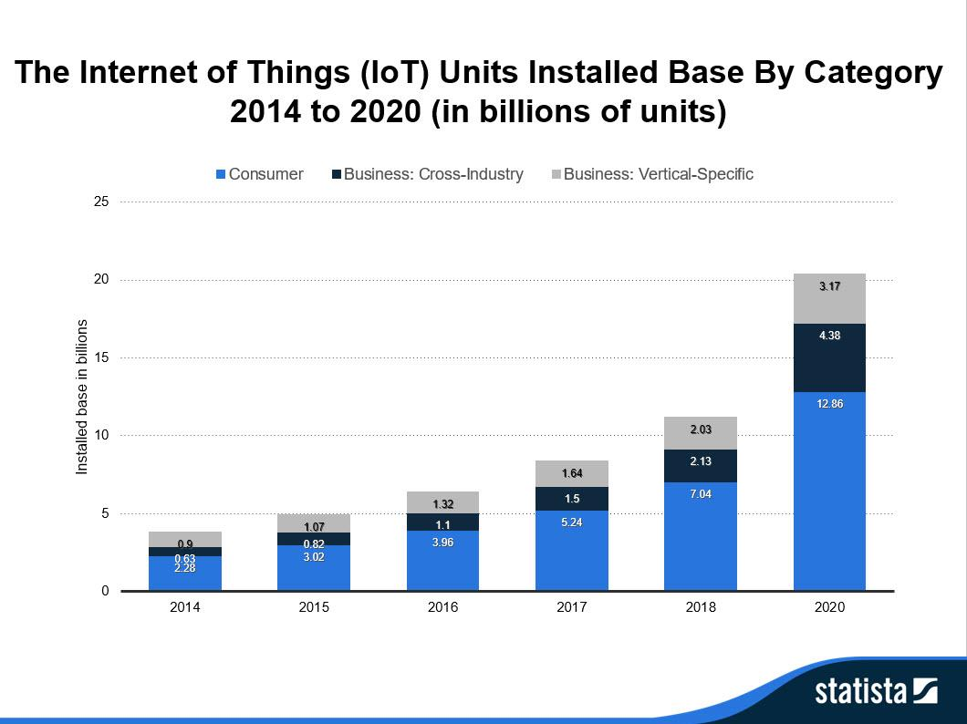

Slide 14
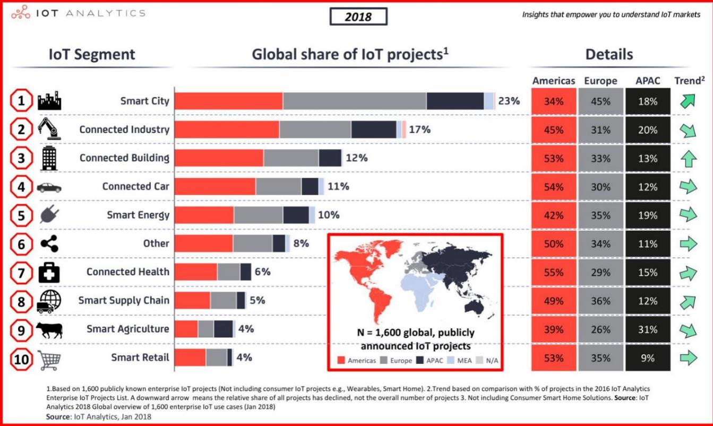
https://www.forbes.com/sites/louiscolumbus/2018/06/06/10-charts-that-will-challenge-your-perspective-of-iots-growth/#ce3f6623ecce

Slide 15
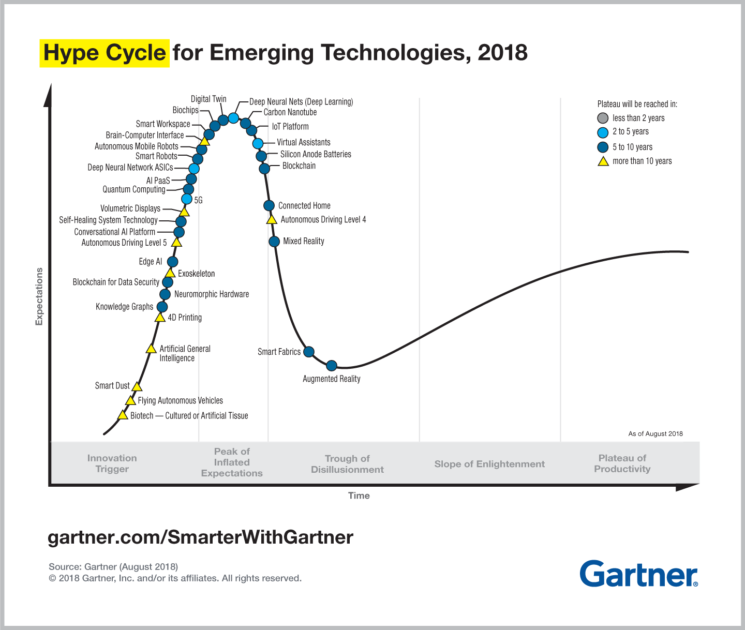

Slide 16
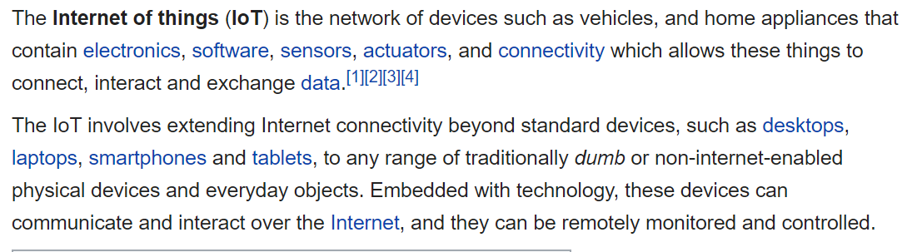
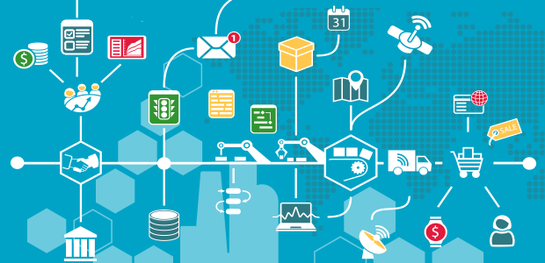
THE INTERNET OF THINGS
IOT IS JUST AN ENABLING TECHNOLOGY!

Slide 17
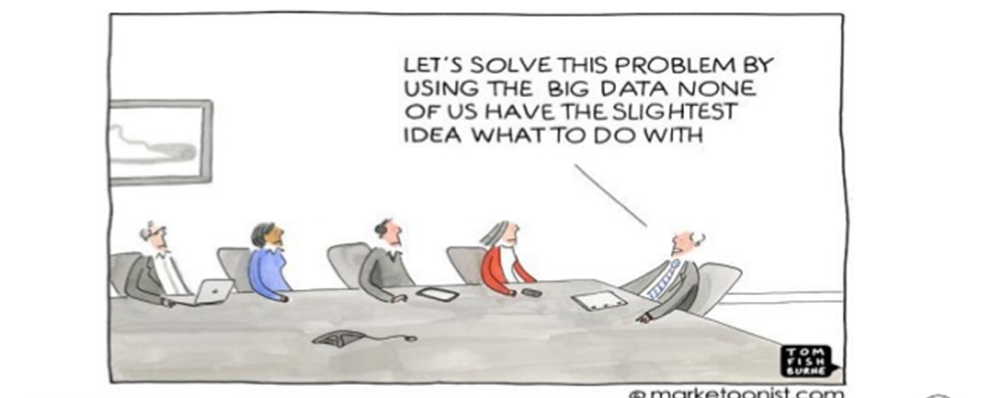

Slide 18
PRODUCTS AND SERVICES IN THE 4.0 ERA

Slide 19
From Products to Services in I4.0
BEFORE USE
“anticipated use”
DURING USE
“actual use”
AFTER USE
“digested use”
Anticipation of product usage, without having actually used it
Effective task fulfillment
Efficient
Satisfying
Mental processing of the experienced use
Emotional retention (or distance) to the product
Designing a Single Product Experience
USABILITY
USER EXPERIENCE
Ethics
Customer Research
Customers’ Perspective of Experience across Touchpoints
CUSTOMER EXPERIENCE
Sales
Advertising
Customer Service
Product Delivery
SERVICE DESIGN
Org Design
Personnel
Product
Business Strategy
Designing In-Person Services for Customers

Slide 20
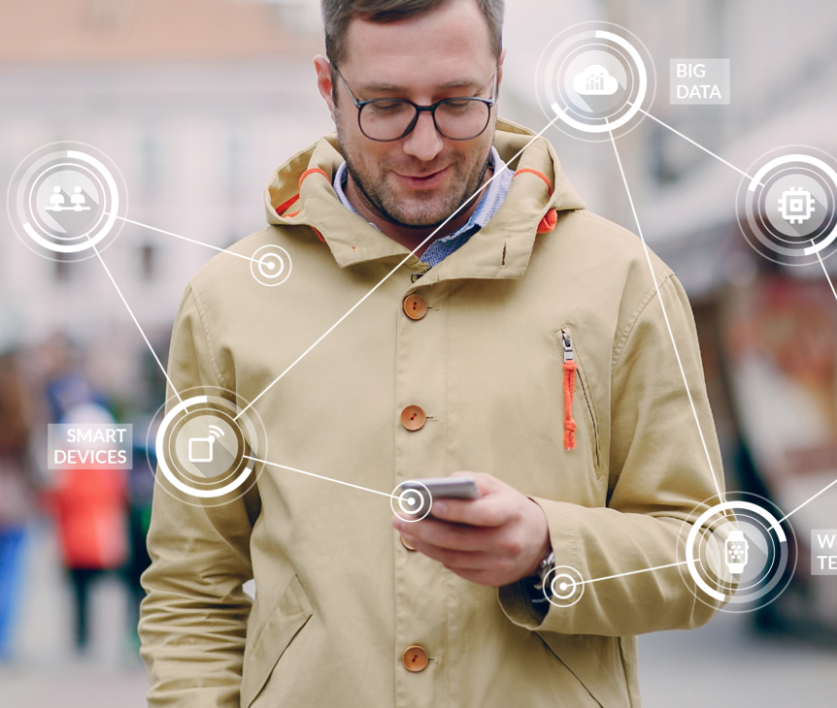
UBIQUITOUS TECHNOLOGY AND BIG DATA

Slide 21
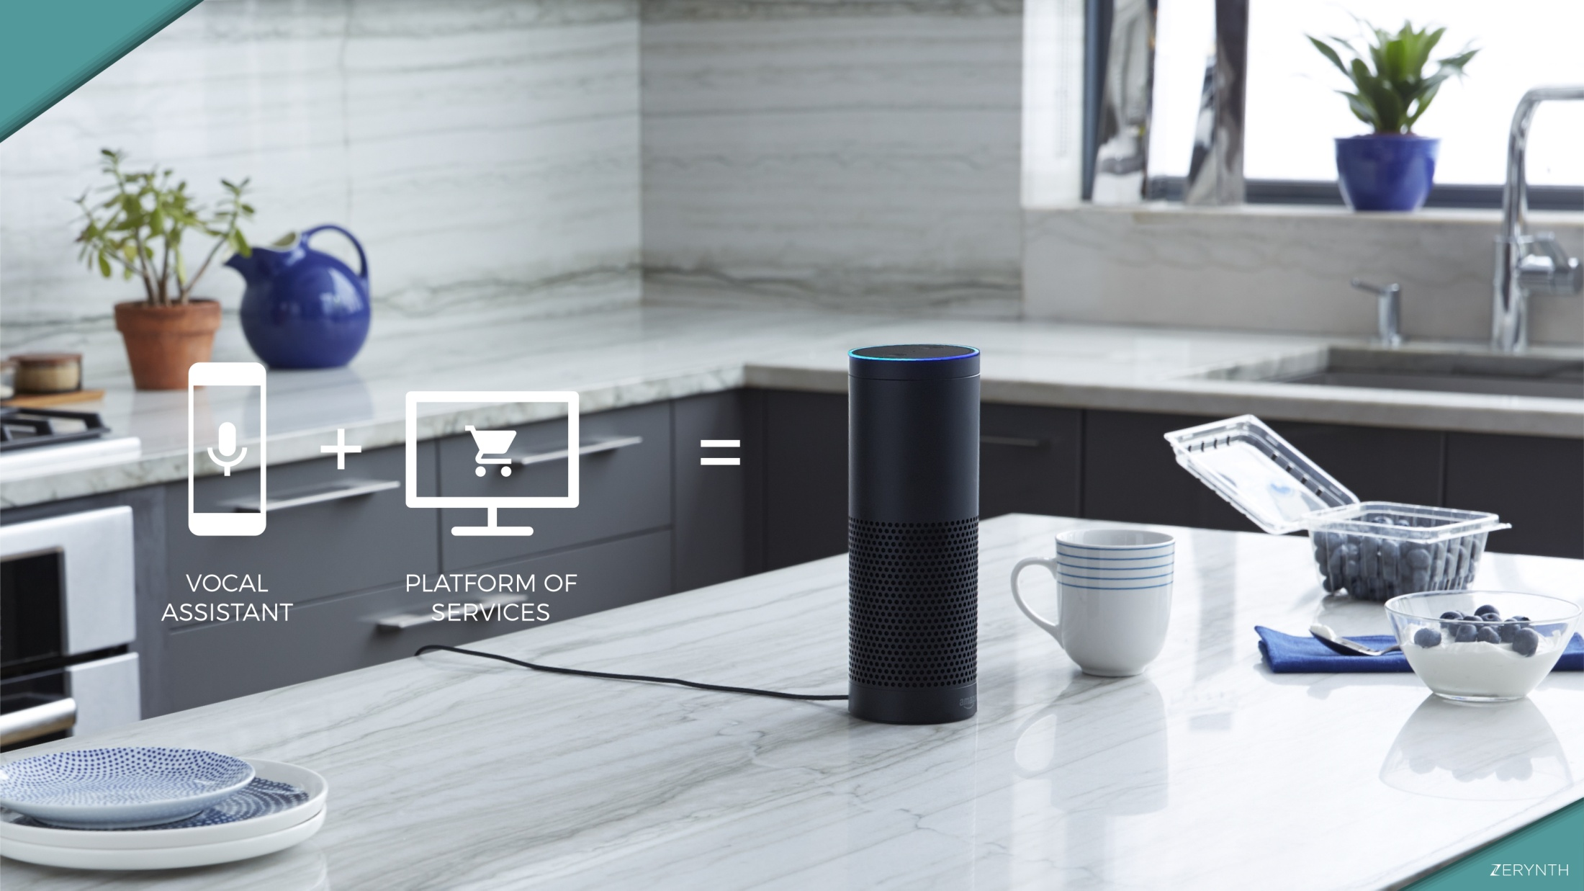
4.0 SMART PRODUCTS AND SERVICES
A smart product is a physical device with a digital service at its heart
‹#›

Slide 22
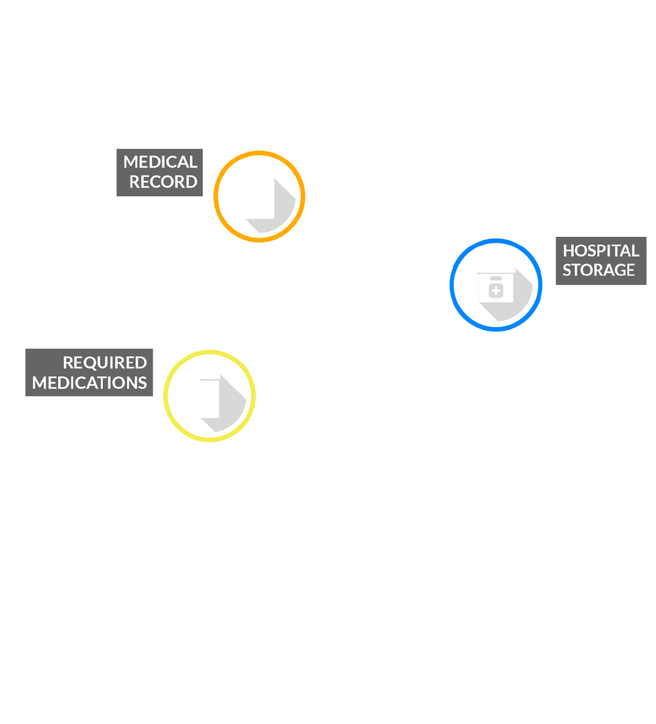
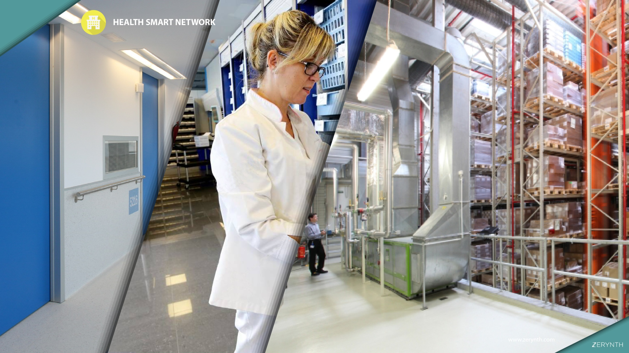


Slide 23
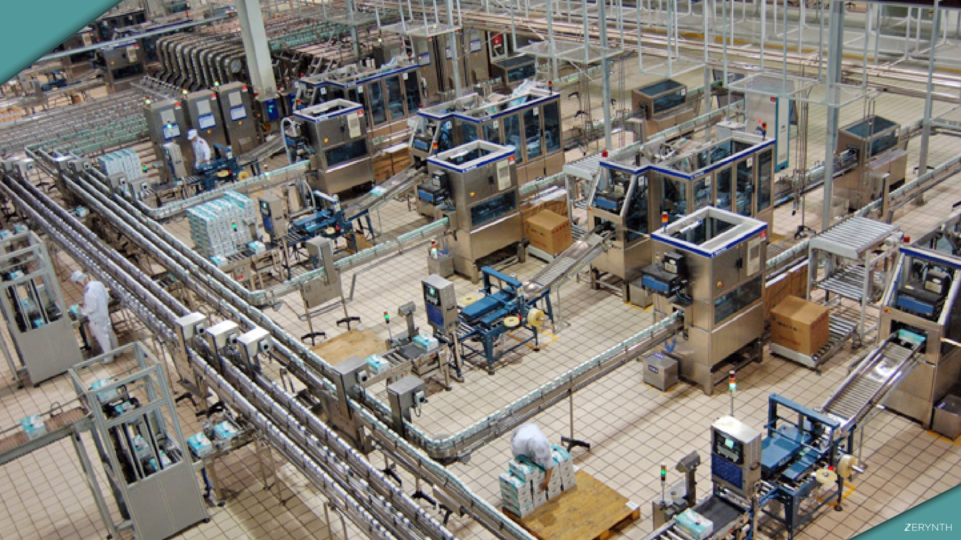






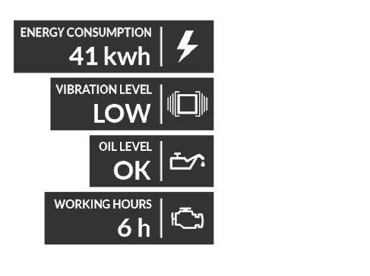


FACTORY ON INTERNET
www.zerynth.com

Slide 24
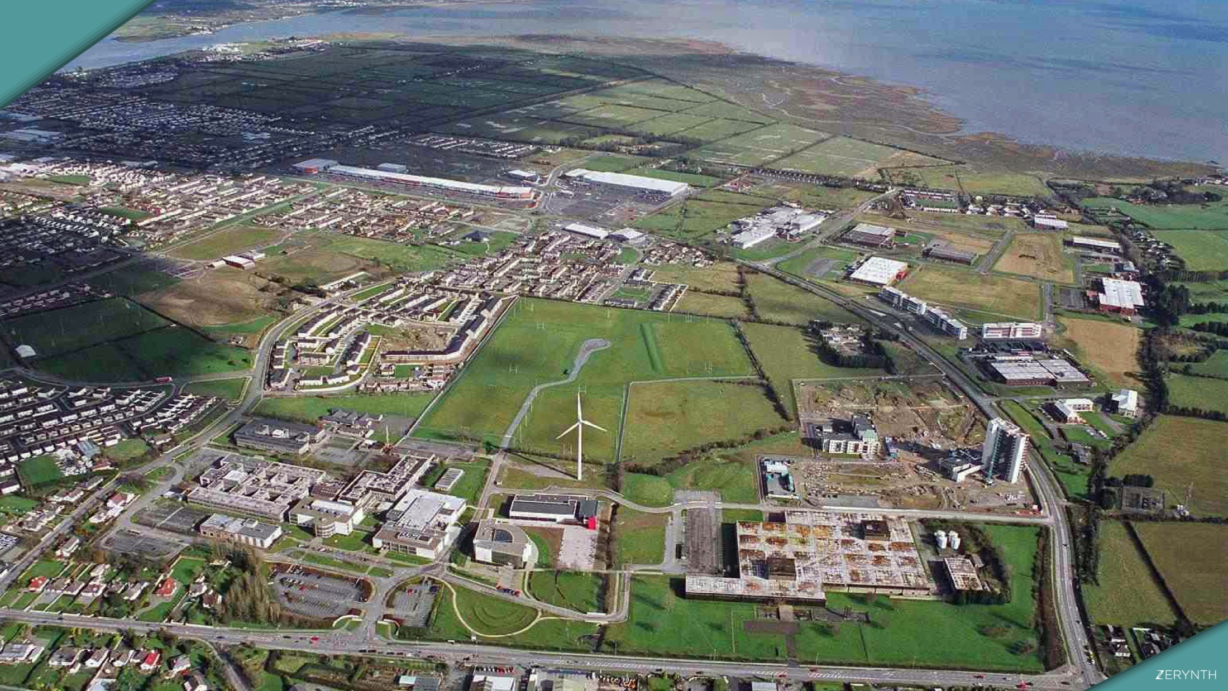





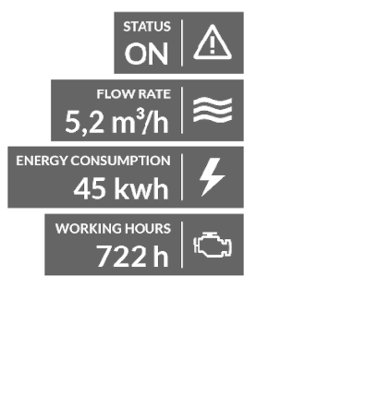


WELLS ON INTERNET

Slide 25
NEW DESIGN PRINCIPLES

Slide 26
UX for IOT
Designing for the IoT is inherently more complex than web service design.
Some of this is to do with the current state of the technology.
Some of this reflects our as-yet immature understanding of compelling consumer IoT value propositions.
Some of this stems from the fact that there are more aspects of design to consider. Tackling them independently creates an incoherent user experience (UX).

Slide 27
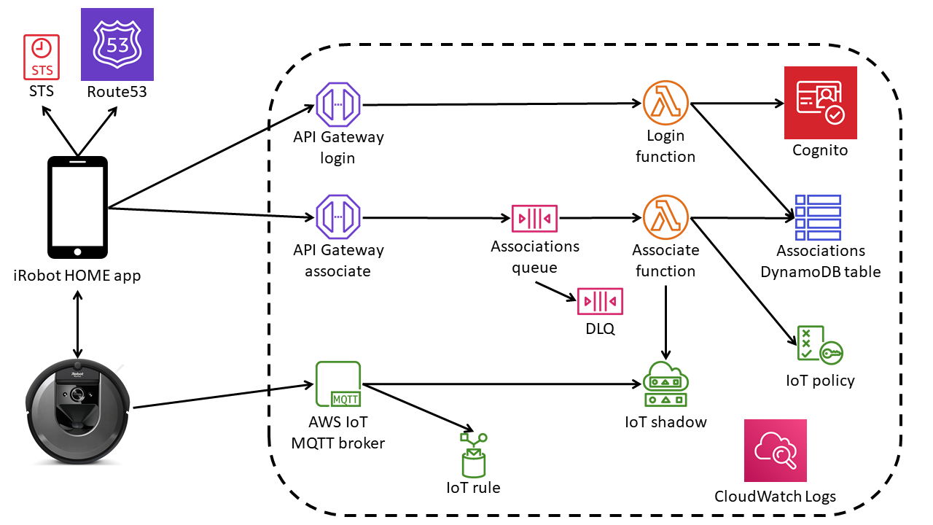
UX for IOT
Designing a great connected product requires a holistic approach to user experience.
It spans many layers of design, not all of them immediately visible.
https://aws.amazon.com/solutions/case-studies/irobot-iot/

Slide 28
Why UX for IOT is different?
Connected products pose design challenges that will be new to designers accustomed to pure software services.
Many of these challenges stem from:
• The specialized nature of IoT devices
• Their ability to bridge the digital and physical worlds
• The fact that many IoT products are distributed systems of multiple devices
• The quirks of networking

Slide 29
Specialized Devices, with Different Capabilities
Many of the “things” in the Internet of Things are specialized, embedded computing devices. Unlike general-purpose computers (smartphones and PCs), their hardware and software is optimized to fulfill specific functions.
Their physical forms must be designed and engineered.
Their UI capabilities may extend from screens and buttons into physical controls, audio, haptics, gestures, tangible interactions, and more.
But user interactions must be designed without the benefit of the style guides and standards that web and mobile designers can rely upon.
Some may have no user input or output capabilities at all. The only way to find out what they are doing or what state they are in may be via a remote UI.

Slide 30
Real-World Context
Connected products exist in the physical world.
Sensors enable us to capture data we did not have before for digital transmission, allowing us to take more informed actions in the real world.
Actuators provide the capability for digital commands to produce real-world effects.
They can be remotely controlled, or automated. But unlike digital commands, real-world actions often cannot be undone.

Slide 31
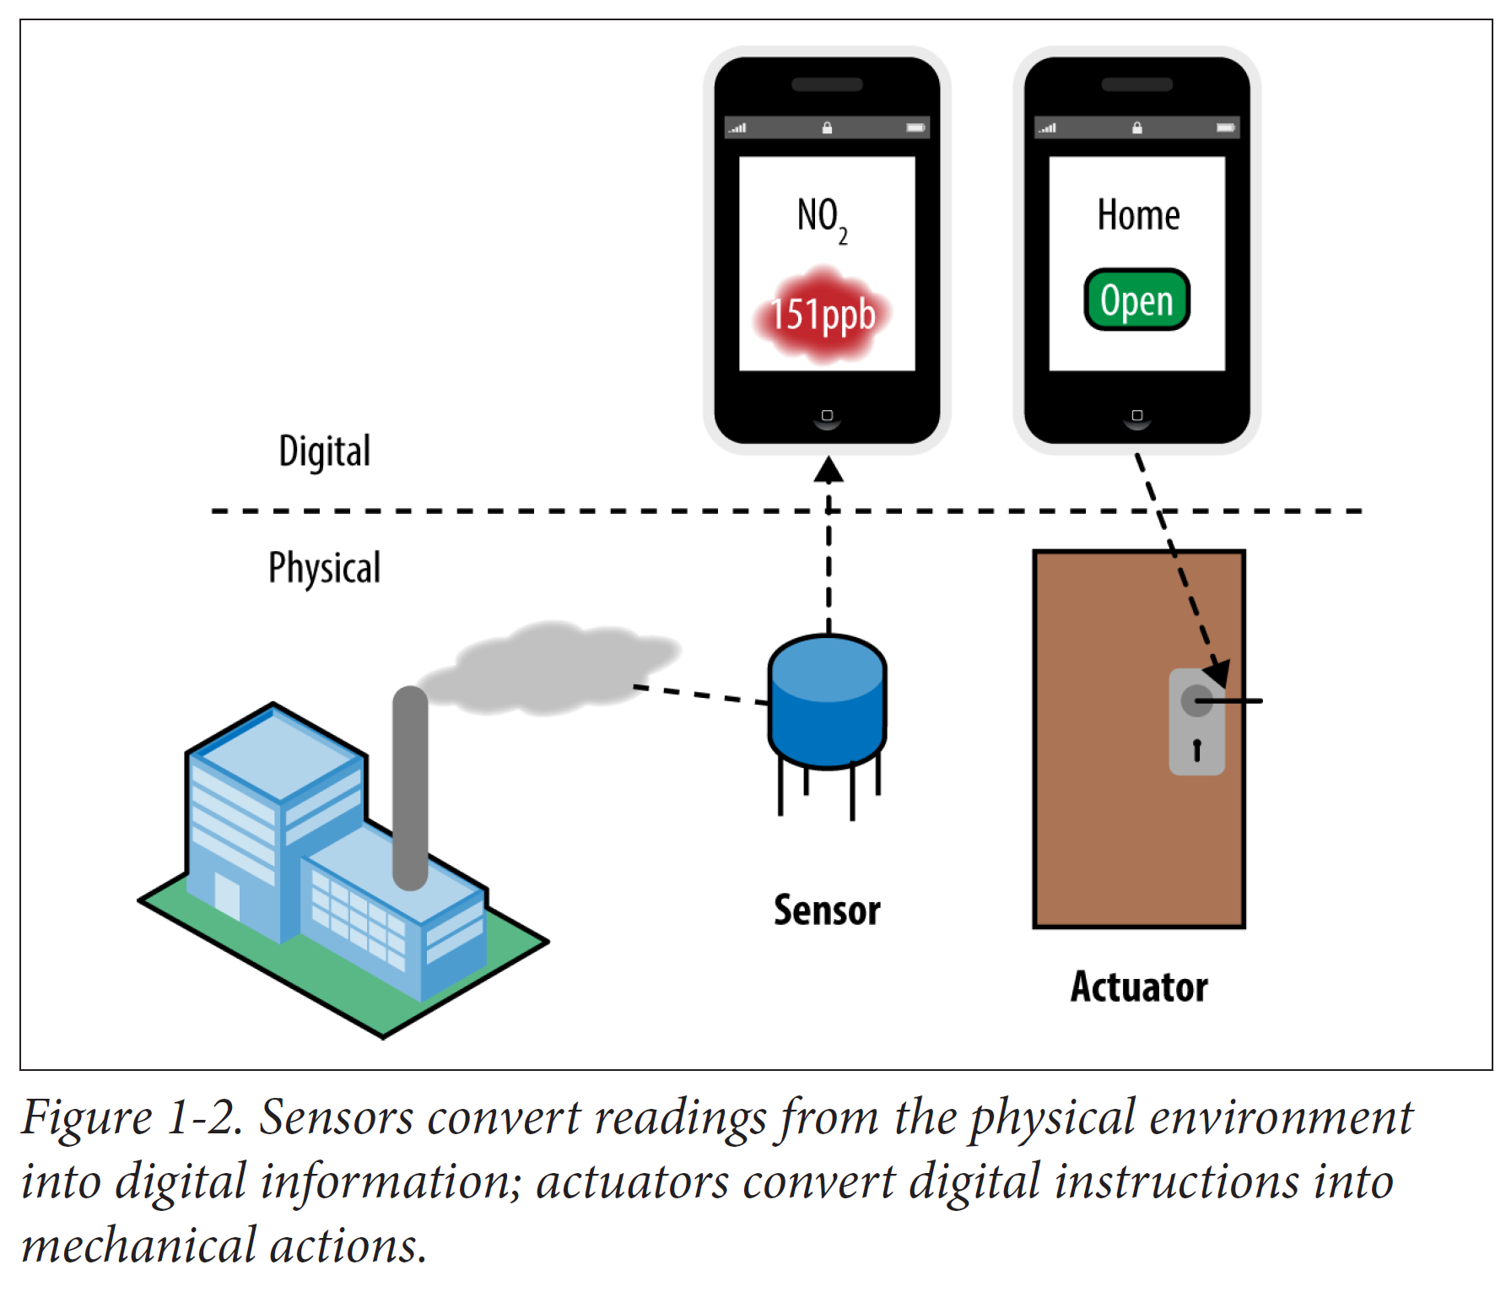
https://www.oreilly.com/library/view/user-experience-design/9781492048145/

Slide 32
Real-World Context
The physical context of use creates further challenges.
Devices may need to be ruggedized for outdoor use.
An in-car system needs to be designed to minimize distraction while driving.
A remotely controlled oven needs to minimize the risk of fire.
Devices must adhere to regulatory requirements such as radio interference or waste recycling standards.
And the social context of use may be particularly complex, especially in the home.
Techno-centric solutions which are insensitive to the needs of the occupants will fail. For example, an assisted living product needs to balance the need of vulnerable people
for safety and support, while preserving their privacy and
autonomy.

Slide 33
Designing for Systems of Devices and Services
Many connected products are systems of diverse devices and services.
Functionality may be distributed across multiple devices with different capabilities.
Designers need to consider how best to distribute functionality across devices.
They need to design UIs and interactions across the system as a whole — not treating devices as standalone UIs — to ensure that the overall UX is coherent.
This is interusability. Much of the information processing for an IoT product will often happen in the Internet service. So the whole system experience is often equally or more important than any single device UX.

Slide 34
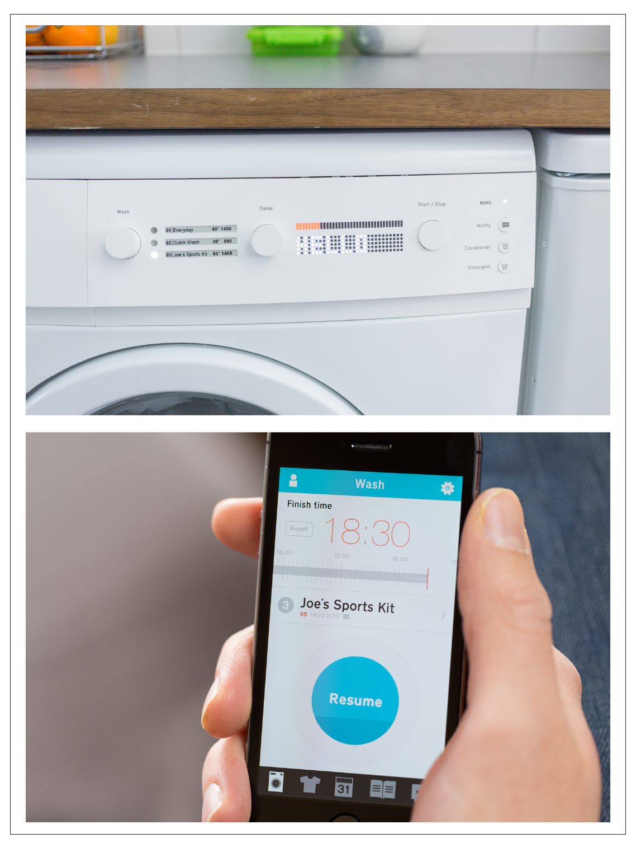

Slide 35
Designing for Systems of Devices and Services
Furthermore, they need some understanding of how the system works.
Even quite simple connected products are conceptually more complex than non-connected ones.
Code can run in more places. Parts of the system will inevitably go offline from time to time.
When this happens, basic knowledge of which component does what will help users understand the consequences, and figure out what action may be required.

Slide 36
Designing for Systems of Devices and Services
In this context, the designers and engineers of connected products should do their best to create a unified environment for the IoT system.
In other words, the challenge of a seamless experience is to integrate diverse independent components into a one-stop solution while saving its functionality and reliability.

Slide 37
Direct vs remote configuration
Over the last 30 years, the prevailing trend in UI design has been direct manipulation.
Users control visual representations of objects and immediately see the outcome of their actions (which can be reversed)
But many IoT interactions are displaced in location (remote control) or time (automation). This breaks the link between user actions and visible, reversible consequences!

Slide 38
Design for Networks
Another major factor is the impact of the network on UX.
Designers from web and mobile software backgrounds have the luxury of assuming that devices will be nearly always connected.
In IOT this is not true anymore!

Slide 39
Design for network
Our experience of the physical world is that things respond to us immediately and reliably.
Light switches do not “lose” our instructions or take 30 seconds to produce an effect.
Delays and glitches are inherent properties of physical networks and transmission protocols.
But they may feel strange experienced through “real-world” things. It’s impossible to engineer these issues entirely out of any Internet-connected system.

Slide 40
Design for power saving
In addition, the nature of connected devices is that they often connect only intermittently, in order to conserve power.
Computers promise to provide us with precise, accurate, and timely data about the world around us.
But distributed IoT systems may not always be in sync, and different devices may therefore report different information about the state of the system.

Slide 41
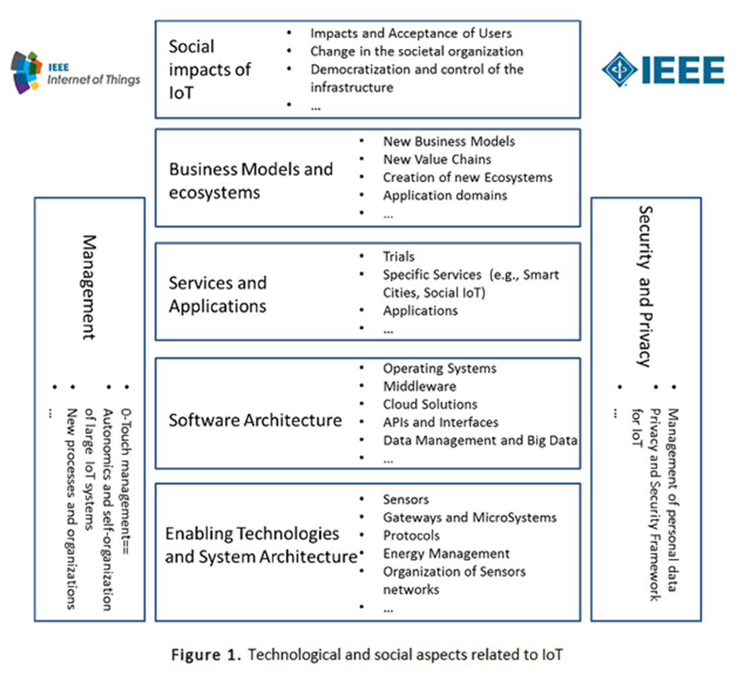
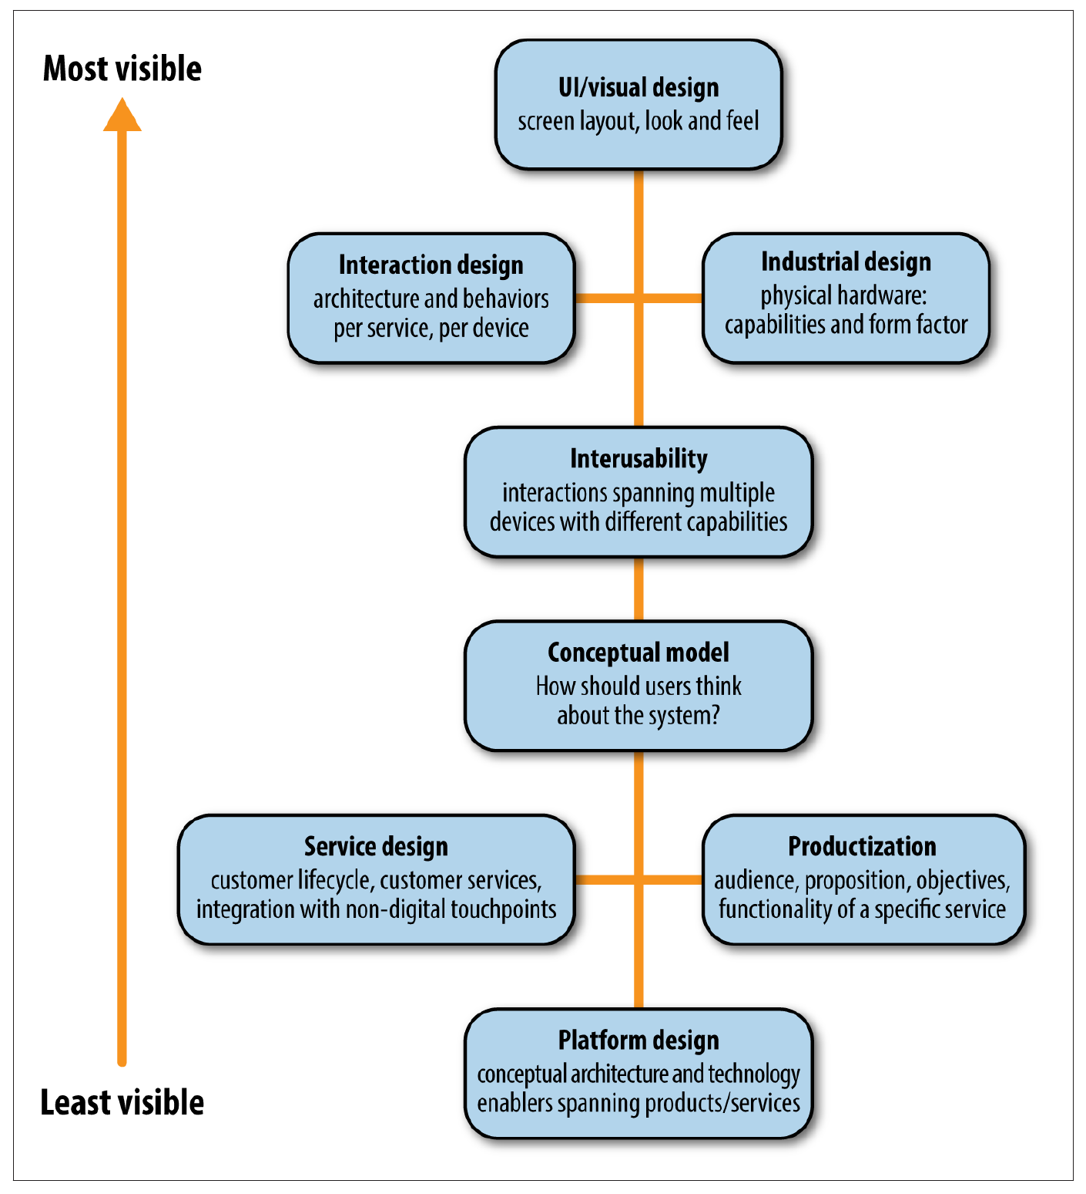
UX for IOT flow and architeture

Slide 42
UX for IOT flow and architecture
A good overall product requires integrated thinking across all these layers.
A stunning UI means nothing if your product concept makes no sense.
A beautiful industrial design may sell products in the short term, but can’t mask terrible service.

